Slide 1

Power BI Storage Modes
The Ultimate Showdown
Patrick and Phil
Microsoft

Slide 2

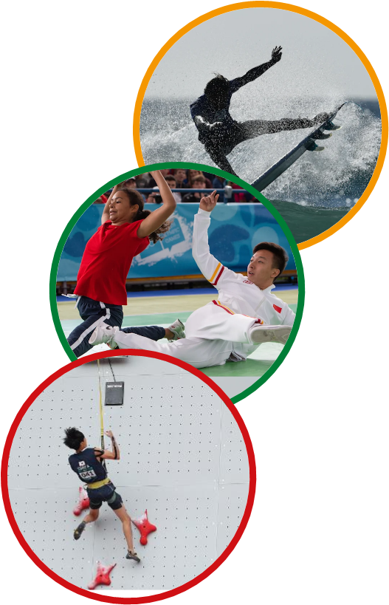
Agenda
The Arena
Five Events – The data modelling Pentathlon
Meet the four competitors
Medal ceremony
Summary and Questions

Slide 3
STORAGE MODE OLYMPICS

Slide 4
The Modern Pentathlon
Fencing
Freestyle swimming
Equestrian show jumping (on unfamiliar horse)
Laser pistol shooting
Cross country running (3km)

Slide 5

The Arena
Microsoft Fabric Lakehouse – F64 Capacity
  25GB Memory per artifact,
1 billion-row fact table, plus four dimension tables
Real life activity usage data (anonymised)

Slide 6

Events
Authoring
Security
Data latency
Model size (SKU required)
DAX Query Speed (double points!!)

Slide 7

Competitor 1 (Norway) : Direct Lake
I came up with a solution for the Fidelity challenge on my bike ride
Newest kid on the block
Only pages data into the model when needed
Lightning fast to ingest data
Only understands one data format (parquet)
Can also use Direct Query when needed

Slide 8

Competitor 2 (Sweden) : Direct Query
Loves real-time scenarios
Great with massive datasets
Can be chatty
Doesn’t require large SKU’s
Older and wiser, maybe not as quick

Slide 9

Competitor 3 (USA) : Import
Supports ALL the data sources
Super fast queries
Optimal query plans
Great compression (10x)

Slide 10

Competitor 4 (NZ) : Composite Mode
Takes the best of Import and Direct Query
Super fast at most DAX queries
Agg-awareness (steroids!)
Less to import
Great value!
More involved to setup

Slide 11
Event 1 : Authoring
To build a simple model using a Fabric Lakehouse table
Add five measures
Publish to workspace
Add a new column to a source table and update model

Slide 12





Event 1 : Authoring : The result!

Slide 13

Event 1 : Authoring : Judges Notes
Direct Lake
  Created in Web, published immediately and can easily be updated
Direct Query
  Create using Power BI Desktop (Windows only)
  Connects to SQL Endpoint, quick to create and publish
  Easy to add new table columns
Import
  Power BI Desktop with 1Bln rows
  Partition management and work required when adding Fact table columns
Composite
  Create using Power BI Desktop (Windows only)
  Need to configure Agg awareness
1st
2nd
3rd

Slide 14
Event 2 : Security
To create two roles
  Phil can see NZ data
  Darren can see Australia data
Ideally, is defined in the source system
Needs to be dynamic
  Use a control table of Users x Geographies
  Adding/Removing user in RLS table is all that is needed
No data-source circumvention

Slide 15
Event 2 : Security : The result!

Slide 16
Event 2 : Security : Judges Notes
Direct Query
  Can be done in Model, or in source (connector needs SSO support)
  RLS Rules in SQL Endpoint can be inefficient
Direct Lake
  Can be done in per model or in SQL Endpoint (causes DQ fallback)
Import
  Only done in the model, RLS rules current per last refresh
Composite
  Can be done in model, and/or in DQ source – but need to keep in sync
1st
2nd
3rd

Slide 17
Event 3: Data latency
Test of speed of access to data
Two parts
  Time to bootstrap/load data initially
  How long before one row added to Fact table shows up?
All about when will reports show the data

Slide 18
Event 3 : Data Latency : The result!

Slide 19
Event 3: Data latency
 | Direct Lake (Warm) | Direct Query | Import | Composite
Bootstrapping | Near instant | instant | 90 mins | Near instant
Access updated data | Near instant | Instant | Depends | Need to manage agg tables

Slide 20
Event 3 : Data Latency : Judges Notes
Direct Query
  Can query as soon as model created
  Updates in data source reflected immediately
Direct Lake
  Near instant access to data for both
Composite
  Fact table in DQ, but need to bootstrap/manage DUAL Dims and import aggregations
Import
  90 minute bootstrap without partitions (20 mins with partitions)
  Data source changes not reflected until refresh complete
1st
2nd
3rd

Slide 21
Event 4: Model size
How much memory is needed to host the model

Slide 22
Event 4 : Model Size: The result!

Slide 23
Event 4: Model Size
 | Direct Lake (Warm) | Direct Query | Import | Composite
Bootstrapping | 1MB to 9GB | 1MB | 9GB+ | 8MB

Slide 24
Event 4 : Model Size : Judges Notes
1st
Direct Query
  1MB Capacity memory required
  No memory needed for cache
Composite
  8MB
  Only Dims (Dual) and Aggregate (Import) tables need to be cached
Direct Lake
  Anywhere between 1MB and 9GB
  Probably closer to 9GB, but only need F64
Import
  9GB model for data
  Additional memory needed for cache, RLS etc.
2nd
3rd

Slide 25
Event 5: Query Speed (Double points!!)
Five common DAX patterns
  Period Comparison
  Running Total
  Rank
  Child/Parent - % of total
  Dreaded Distinct count
  All combined
Total duration

Slide 26
Event 5 : DAX Query Speed : The result!

Slide 27
Event 5 : DAX Query Speed : The result!
 | Direct Lake (Warm) | Direct Query | Import | Composite
Period Comparison | 78ms | 1,200ms | 422ms | 47ms
Running Total | 110ms | 2,100ms | 610ms | 47ms
Rank | 63ms | 830ms | 141ms | 31ms
Percentage of Parent | 47ms | 737ms | 125ms | 16ms
Distinct Count | 5,700ms | 2,800ms | 8,200ms | 3,000ms
All combined | 5,900ms | 4,900ms | 8,500ms | 3,000ms

Slide 28
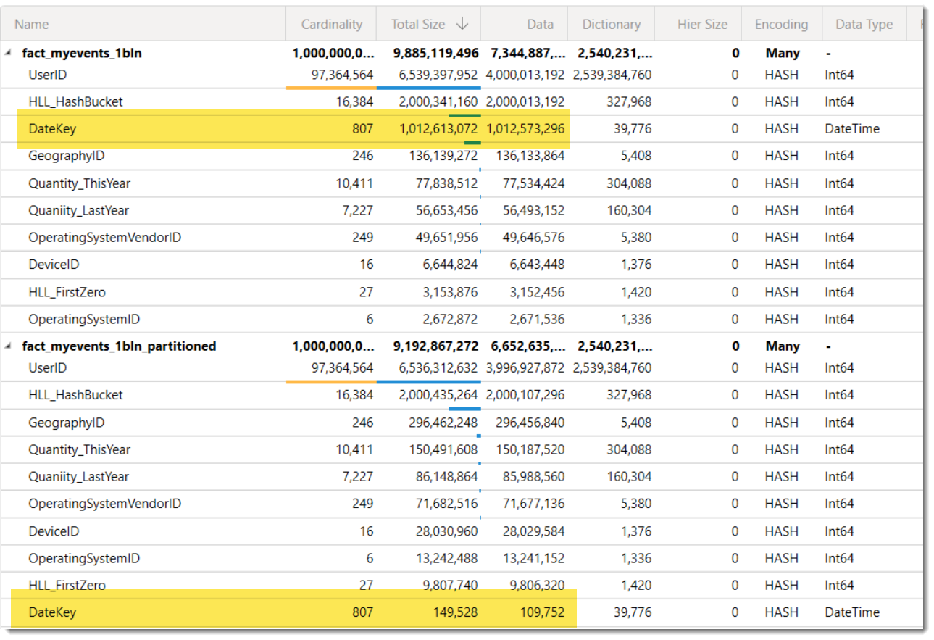
Event 5 : DAX Query Speed : The result!

Slide 29

The Winner is….
 | Direct Lake | Direct Query | Import | Composite
Authoring |  | 2nd | 4th | 4th
Security |  |  | 1st | 4th
Data Latency |  | 1st | 4th | 3rd
Model Size |  | 1st | 4th | 3rd
DAX Query Speed ^{x2} |  | 4th | 3rd | 1st
 | 11pts | 13pts | 20pts | 16pts
1st
2nd
3rd
2nd
1st
3rd
2nd
1st
3rd
2nd
1st
3rd
2nd
3rd
1st

Slide 30
The Winner is….
1st
2nd
3rd

Slide 31

Summary
Your data will have different characteristics
Important to consider all elements of modelling, not just
Data profiles and business priorities may change over time

Slide 32
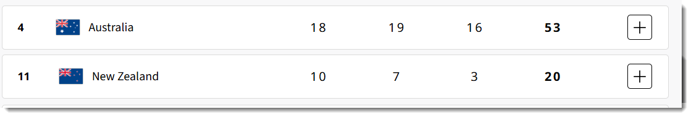
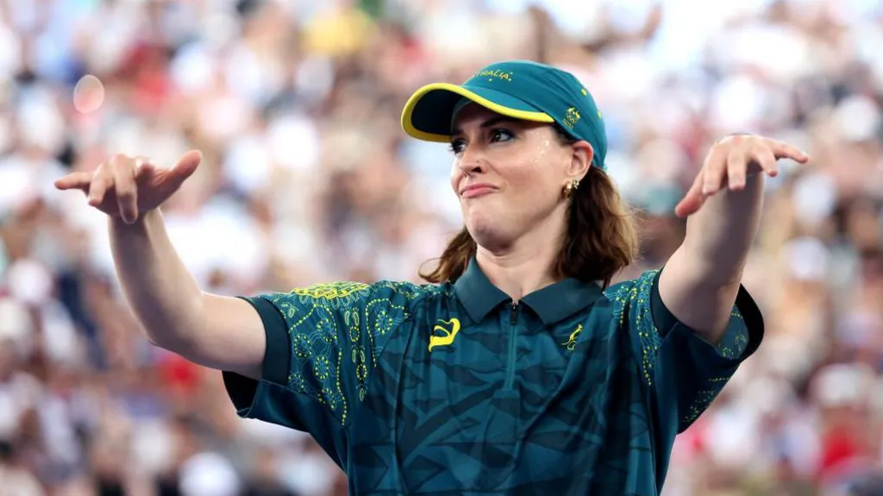
2024 Olympic Medal table

Slide 33
Questions

Slide 34
References
https://learn.microsoft.com/en-us/power-bi/transform-model/desktop-composite-models
Best Practice Analyzer (Now in Semantic Link Labs!)
Delta Analyzer (aka.ms/DeltaAnalyzer)
PBI Guidance

